Slide 1
Libraries, Web Services and APIs
IN712 Web3

Slide 2
JavaScript Libraries
We will start by looking at 3rd party tools we can use in JavaScript development.
Libraries are .js code files that you add to your file structure
They provide methods that you call that do various things
There are, literally, thousands of these floating around
Using them is just normal programming: You have some functions, you figure out their I/O and you call them

Slide 3
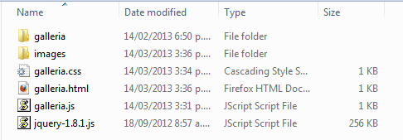
JavaScript Libraries
Example: Galleria, a JavaScript image gallery framework that simplifies the process of creating image galleries for the web and mobile devices
Download from www.galleria.io
Unzip and drop in folder with your .html page

Slide 4
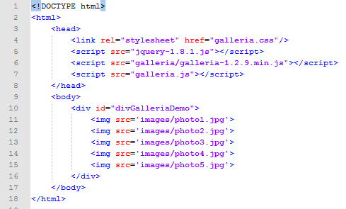
Galleria – The HTML
Just make a div with a bunch of <img> in it…

Slide 5
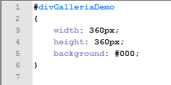
Galleria – The CSS
Notes:
Size the div….

Slide 6
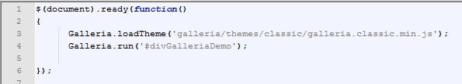
Galleria – The JavaScript
Easy
Two lines of code.
The ‘classic’ theme is free with the download; you can get others.

Slide 7
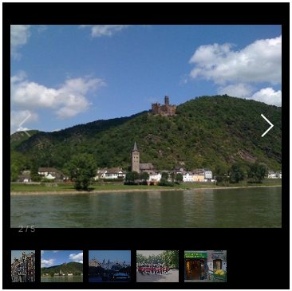
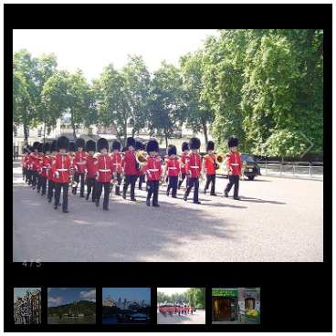
Galleria – The Result
So, if you ever need some fairly standardised functionality in your javaScript, take a quick Google for an existing 3rd party library. It can save a great deal of coding effort.

Slide 8
Web Service or API?
The concepts definitely overlap
Both allow your web page to consume computation performed on another machine.
Some people use the term interchangeably

Slide 9
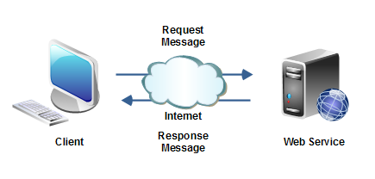
Web Services

Slide 10
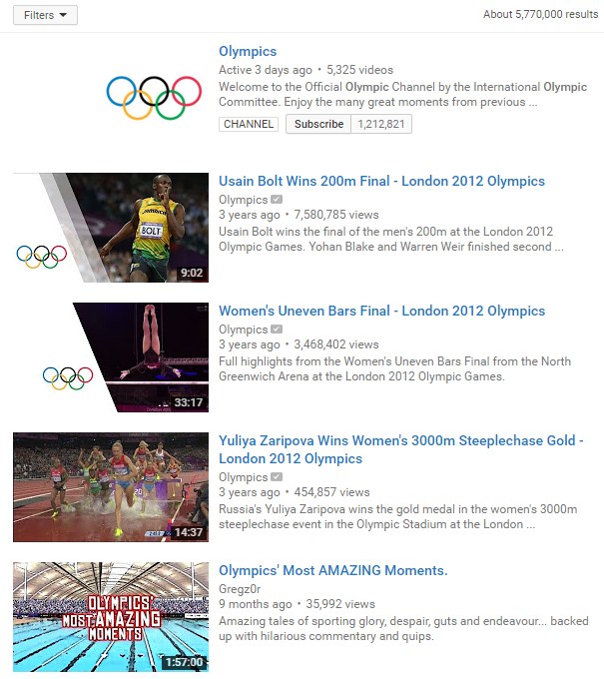
Simplest Web Service
The very simplest remote access is just flicking an http GET request in the shape of a URL with a query string
Many of these services require an authorisation key, which is included in the query string.
Keys are usually free, and allow a limited number of searches per day
https://www.youtube.com/results?search_query=olympics

Slide 11
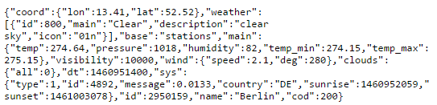
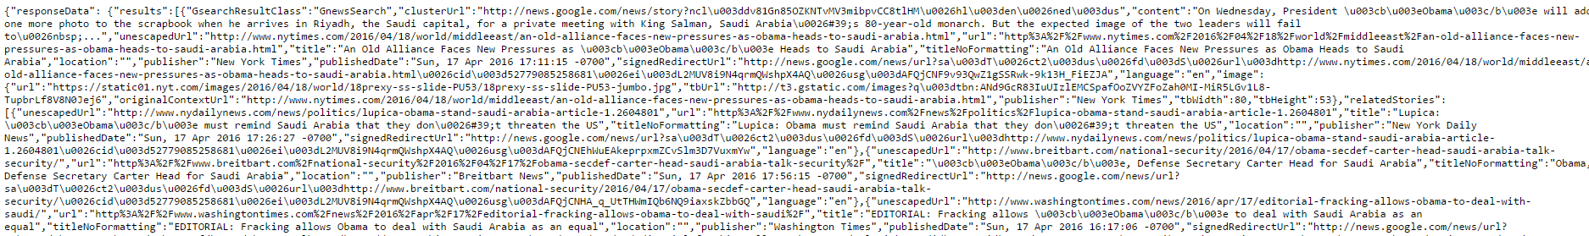
Simplest Web Service
You can get all sorts of useful information by simply retrieving Json data from a URL
http://api.openweathermap.org/data/2.5/weather?q=berlin
https://ajax.googleapis.com/ajax/services/search/news?v=1.0&q=obama
http://liveweave.com/jksikA

Slide 12
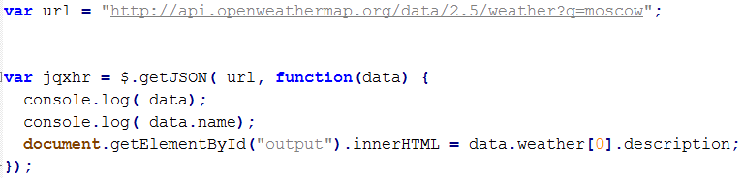
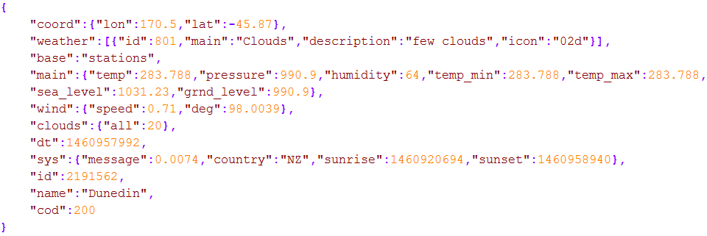
Getting the Data of a Web API

Slide 13
Web APIs
Often Web APIs display OO interfaces. They provide classes which expose methods.
When working with an API, you first load up a library, which contains the declaration of objects that you can use to consume the remote computation.
The objects will have methods to call and very specific interface requirements for those methods. You need to spend time with the documentation for whatever API you want to use.
Google Chart API
Load the library
Prepare a data set object
Define chart options
Pass the object to a Google chart object generating method
Call the chart object’s draw method
The chart displays as a vector graphic in your web page

Slide 14
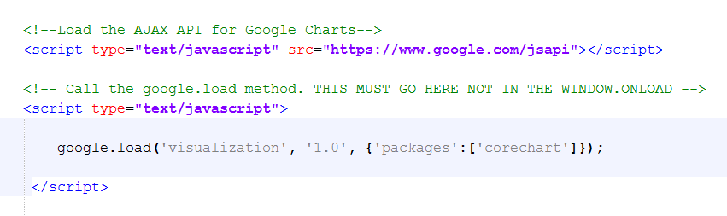
Google Chart API
In the HTML <head>: Load the library

Slide 15
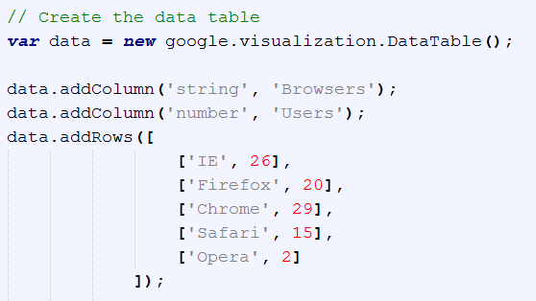
Google Chart API
In the JavaScript: Prepare a Data Set Object

Slide 16
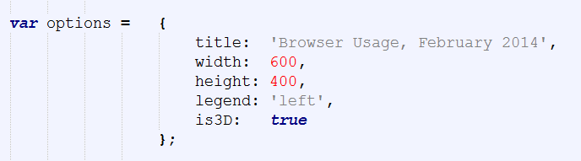
Google Chart API
Define chart options

Slide 17
Google Chart API
Pass the object to a Google chart generating method
Call the chart object’s draw method

Slide 18
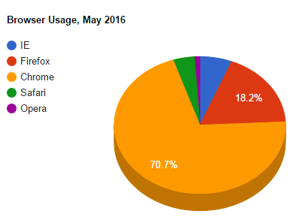
Google Chart API
The chart displays as a vector graphic in your web page
http://liveweave.com/AUBS26

Slide 19
Useful Link
50 Most Useful APIs for Developers:
http://www.computersciencezone.org/50-most-useful-apis-for-developers/

Slide 20
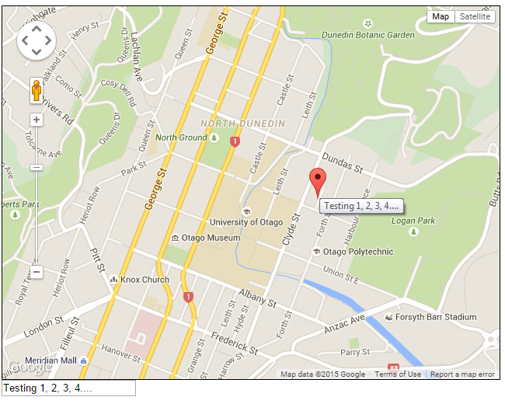
Practical – Google Maps
Lots of useful hints:
Google Maps JavaScript API
https://developers.google.com/maps/documentation/javascript/tutorial

